Slide 1



Master
Lesson 16 - SQL
Using Window Functions
by
Bryan Cafferky
Data and AI Enabler

Slide 2
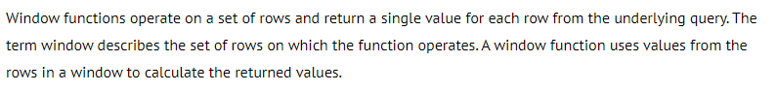
What are Window Functions?
https://drill.apache.org/docs/sql-window-functions-introduction/

Slide 3
What are Window Functions?
Perform a calculation across a set of rows that are somehow related to the current row.
Similar to an aggregate function but does not consolidate rows.
The window function is able to access more than just the current row of the query result.

Slide 4
Demo

Slide 5
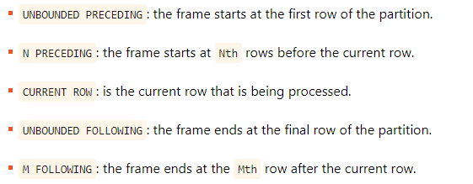
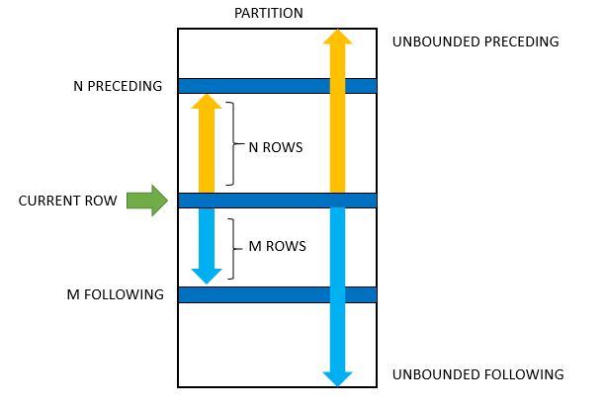
Frame within a Partition
ROWS specifies the offset of the current row, and the frame rows are row numbers. On the other hand, RANGES indicates that the offset of the current row and frame rows are row values.
Note that RANGE must use only with UNBOUNDED or CURRENT ROWS option.
Default Settings:
RANGE BETWEEN UNBOUNDED PRECEDING AND CURRENT ROW
https://www.sqlitetutorial.net/sqlite-window-functions/sqlite-window-frame/

Slide 6
Wrapping Up
What are Window Functions?
Use Cases of Windows Functions
Thank You!

